Slide 1
BEYOND THE BRUSH
A PRESENTATION ON THE ORAL & DENTAL WELL BEING OF AN INDIVIDUAL
UNDERSTANDING ORAL &
DENTAL HYGIENE AWARENESS

Slide 2
A project by
AUM NARESH CHALKE TS2324053
UNDER THE GUIDANCE OF
PALLAVI REGE (HOD)
PRACHI VAIDYA
SIDDHANT MARATHE
SHABHNAAZ KHAN

Slide 3




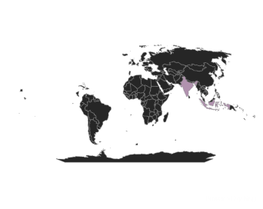
DASHBOARD
205 | 103 101 | 1
TOTAL RESPONSES | MALE FEMALE | OTHERS
DIFFERENT INTERVAL OF AGES
RESPONSES BY LOCATION
RESPONSES BY COUNTRY 6 DIFFERENT COUNTRIES
18-25
178
URBAN
125
25-35
9
35-45
6
SUBURBAN
60
45-55
3
55-65
1
RURAL
20
65 AND ABOVE
8

Slide 4
INTRODUCTION TO THE TOPIC
The project “Beyond The Brush” checks the intricacies of dental hygiene, aiming to illuminate the diverse factors influencing practices & access to dental care.
Through a comprehensive analysis of more than 150+ responses, this study explores the frequency of dental check-ups, dietary habits, lifestyle choices, and financial barriers that an individual faces in maintaining optimal oral health.
By investigating these factors, the project seeks to uncover insights that can enhance oral health outcomes and promote better dental hygiene practices.
Through statistical analysis and data visualization we aims to provide a deeper understanding of the challenges and opportunities in dental hygiene awareness and care, paving the way for more informed oral health strategies and policies

Slide 5
OBJECTIVES
To spread awareness amongst people about oral hygiene
To look into common ideas people have about oral hygiene
Study the factors associated with oral hygiene amongst people
Establish relationship between oral health and overall well being of a person
To identify the problems faced by people(higher treatment cost) to maintain oral hygiene
To lay emphasis on the importance of visiting a dental health care center routinely

Slide 6
FLOW OF STUDY
Designing of questionnare
Analysis of
data
Conclusion
01
03
05
02
04
Collection of
data
Interpretation of
data

Slide 7
Designing of questionnare
01
The questionnare has been designed keeping in mind the objectives of our project and making it as simple and convinient as possible and keeping peoples perspective in mind.

Slide 8
FLOW OF STUDY
Designing of questionnare
Analysis of
data
Conclusion
01
03
05
02
04
Collection of
data
Interpretation of
data

Slide 9

02
Collection of data
The data which we have got is primary data since we got it through google forms.
Most of our data comes from the people of age between 18 to 25.

Slide 10
FLOW OF STUDY
Designing of questionnare
Analysis of
data
Conclusion
01
03
05
02
04
Collection of
data
Interpretation of
data

Slide 11

03
Analysis of data
Since our data is primary and raw, we have to make it proper. To do that we sorted our data and some and did data sorting to make the data more meaningful.

Slide 12
FLOW OF STUDY
Designing of questionnare
Analysis of
data
Conclusion
01
03
05
02
04
Collection of
data
Interpretation of
data

Slide 13

04
Interpretation of data
Since our data is primary and raw, we have used some tests like chi-square test, t-test etc. using some softwares like IBM-SPSS and computer languages like R-studio and python.

Slide 14
FLOW OF STUDY
Designing of questionnare
Analysis of
data
Conclusion
01
03
05
02
04
Collection of
data
Interpretation of
data

Slide 15

Conclusion
05
After all the tests and analysis, we concluded with the appropriate result and hypothesis.

Slide 16
FLOW OF STUDY
Designing of questionnare
Analysis of
data
Conclusion
01
03
05
02
04
Collection of
data
Interpretation of
data

Slide 17
Research Methodology
DATA TYPE | PRIMARY
SAMPLE SIZE | 205
SAMPLING MATHOD | SIMPLE RANDOM SAMPLING
TARGET POPULATION | ALL THE PEOPLE
ANALYSIS METHOD | GRAPHICAL REPRESENTATION, CHI-SQUARE METHOD, ORDINAL & MULTINOMIAL LOGISTIC REGRESSION

Slide 18
Graphical Representation
1
AGE
4
WHEN WAS YOUR LAST DENTAL CHECKUP AND CLEANING?
5
IF YOU WERE UNABLE TO GET ORAL
HEALTH CARE,WHAT WAS THE REASON?
2
GENDER
3
LOCATION
6
HOW SATISFIED ARE YOU WITH THE AVAILABILITY OF INFORMATION ON ORAL HEALTH AND DENTAL CARE?

Slide 19
1
2

Slide 20
Graphical Representation
1
AGE
4
WHEN WAS YOUR LAST DENTAL CHECKUP AND CLEANING?
5
IF YOU WERE UNABLE TO GET ORAL
HEALTH CARE,WHAT WAS THE REASON?
2
GENDER
3
LOCATION
6
HOW SATISFIED ARE YOU WITH THE AVAILABILITY OF INFORMATION ON ORAL HEALTH AND DENTAL CARE?

Slide 21
3
4

Slide 22
Graphical Representation
1
AGE
4
WHEN WAS YOUR LAST DENTAL CHECKUP AND CLEANING?
5
IF YOU WERE UNABLE TO GET ORAL
HEALTH CARE,WHAT WAS THE REASON?
2
GENDER
3
LOCATION
6
HOW SATISFIED ARE YOU WITH THE AVAILABILITY OF INFORMATION ON ORAL HEALTH AND DENTAL CARE?

Slide 23
5
6

Slide 24
Graphical Representation
1
AGE
4
WHEN WAS YOUR LAST DENTAL CHECKUP AND CLEANING?
5
IF YOU WERE UNABLE TO GET ORAL
HEALTH CARE,WHAT WAS THE REASON?
2
GENDER
3
LOCATION
6
HOW SATISFIED ARE YOU WITH THE AVAILABILITY OF INFORMATION ON ORAL HEALTH AND DENTAL CARE?

Slide 25

Factors associated with oral health
BRUSHING
How often do you brush your teeth each day ?
SUGAR CONSUMPTION
FLOSSING
How often do you consume sugary substance(soda, chocolate etc.)
How frequently do you floss?

Slide 26
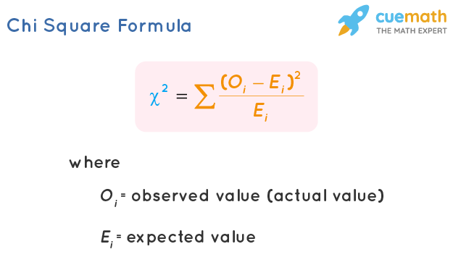
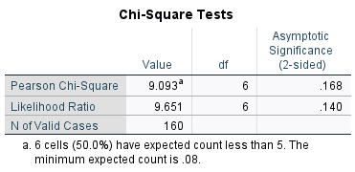
Chi-square test of independence
H₀ : There is no significant V/S H₁ : There is significant
association in oral health association in oral health
and brushing teeth everyday. and brushing teeth.
We tested if there exists a relationship between overall oral health and frequency of brushing. We used Chi-square test of independence and found the chi-square value=9.093 and the p value>0.05. Hence, we do not reject our null hypothesis and conclude that the two variables are independent.

Slide 27
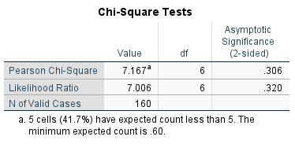
Chi-square test of independence
H₀ : There is no significant V/S H₁ : There is significant
association in oral health association in oral health
and frequency of flossing. and frequency of flossing.
We tested if there exists a relationship between overall oral health and frequency of brushing. We used Chi-square test of independence and found the chi-square value=7.167 and the p value>0.05. Hence, we do not reject our null hypothesis and conclude that the two variables are independent.

Slide 28
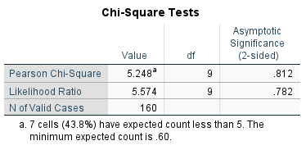
Chi-square test of independence
H₀ : There is no significant V/S H₁ : There is significant
association in oral health association in oral health
and sugar consumption. and sugar consumption.
We tested if there exists a relationship between overall oral health and frequency of brushing. We used Chi-square test of independence and found the chi-square value=5.248 and the p value>0.05. Hence, we do not reject our null hypothesis and conclude that the two variables are independent.

Slide 29
₹₹ Economical alternative ₹₹
On an average a person spends Rs. 2866 annually on overall dental hygiene according to our data.
The cost for dental cleaning can range from around Rs. 500 to Rs. 3000 or more…

Slide 30
HOW LIKELY ARE YOU TO SEEK PROFESSIONAL DENTAL CLEANING OR TREATMENT IN THE NEXT YEAR?
1

Slide 31
WHAT WOULD ENCOURAGE YOU TO SEEK PROFESSIONAL DENTAL TREATMENT MORE REGULARLY?
2
3
HOUSEHOLD INCOME ANNUALLY

Slide 32
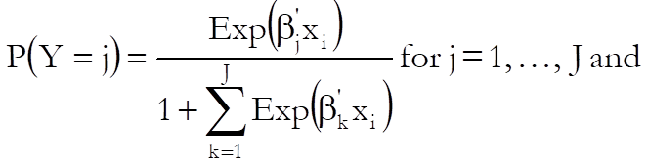
Multinomial Logistic Regression
Multinomial logistic regression is a type of regression analysis used to predict outcomes with more than two categories.
It estimates the probabilities of each category occurring based on predictor variables.
MODEL:

Slide 33
In our model,
DEPENDENT VARIABLE:
How likely are you to seek professional dental cleaning or treatment in the next year ?
Values: very likely, somewhat likely, not likely, and if necessary
INDEPENDENT VARIABLES:
Household income annually
Values: less than 3 lakhs, 3 lakhs–6 lakhs, 6 lakhs–9 lakhs,
9 lakhs-12 lakhs, 12 lakhs–15 lakhs, 15 lakhs or above
What would encourage you to seek professional dental treatments more regularly ?

Slide 34
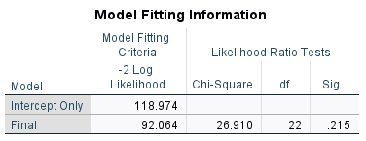
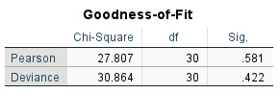
Testing our model,
H₀: There is no significant impact on seeking V/S H₁:There is significant impact.
dental treatments to the level of income and
justification which lead to dental treatment
more regularly.
The Chi-square statistic was not significant (26.91,p>0.05)
Model fitting information –
The model fitness was assessed using chi-square statistic. The chi-square value is 26.91 and p-value>0.05.
This proves that there is no significant relationship between the dependent variable and the independent variable in the final model.

Slide 35
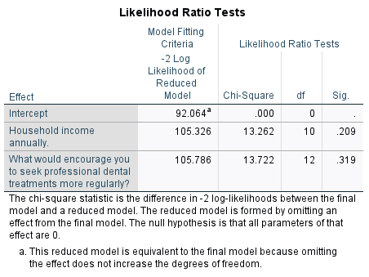
The Likelihood Ratio Test (LRT) proves that the independent or predictor variable like income and encouraging people is not significant which proves that these predictors do not contribute significantly to the final model.

Slide 36
Oral health and overall well being : A Comparative Analysis

Slide 39
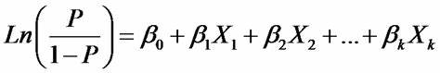
Ordinal Logistic Regression
It is a statistical method used when your dependent variable has ordered categories.
It is similar to multinomial logistics regression but specifically designed for ordinal (ordered) outcomes.
Its used in various fields like education, psychology and public health to analyze and predict ordered outcomes.
MODEL:

Slide 40
In our model,
DEPENDENT VARIABLE:
How would you rate the importance of dental hygiene in overall health ?
Values: 1(excellent), 2(good), 3(fair) and 4(poor)
INDEPENDENT VARIABLES:
Do you have any pre existing health conditions ?
How physically active would you say you are on weekly basis ?
How often do you visit dentist for routine checkups ?
Do you smoke cigarettes or other tobacco products ?

Slide 41
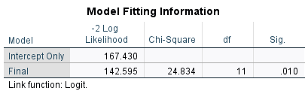
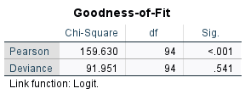
Testing our model,
H₀: There is no significant impact of dependent variable V/S H₁:There is significant impact.
on independent variable.
The chi-square statistic was not significant (24.834,p>0.05)
Model fitting information –
The model fitness was assessed using chi-square statistic.
The chi-square value is 159.630 and p-value<0.001.
This proves that there is no significant relationship between the dependent variable and the independent variable in the final model.
This result suggests poor model fit.

Slide 42
Comparing patient’s last visit to subsequent discomfort experience
CONFUSION MATRIX:
How many dental check-ups have you had in the past year? | NO | YES | GRAND TOTAL
NO | 39 | 26 | 65
YES | 29 | 66 | 95
GRAND TOTAL | 68 | 92 | 160

Slide 44
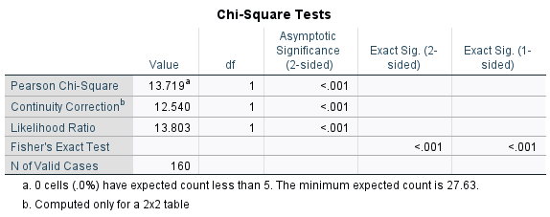
Testing our model,
H₀: There is no significant association V/S H₁: There is significant association.
between a patients last visit and
subsequent discomfort experienced.
We tested if there exists a relationship between patients last visit and subsequent discomfort experienced.
We used chi-square test of independence and found the chi-square value = 13.719 and
p-value<0.001.
Hence we reject our null hypothesis and conclude that the variables are not independent.

Slide 45
Exploring Oral Health Knowledge and Attitudes
1
2

Slide 46
3
4

Slide 47
Conclusion
Awareness and Education: There is a need for increased awareness and education about dental hygiene practices. Many individuals may not be fully aware of the importance of regular dental check-ups and proper oral care routines.
Lifestyle and Oral Health: Lifestyle choices, such as smoking, alcohol consumption, and physical activity levels, may have an impact on oral health.. Dietary habits, particularly the consumption of sugary foods and beverages, play a role in oral health too. Educating individuals about the impact of diet on oral health and encouraging healthier lifestyle choices are important steps in improving overall oral health outcomes and preventing oral diseases.
Further Research: While this study provides some irregular insights, further research is needed to explore additional factors influencing dental hygiene practices and access to care. This could include more detailed analyses of specific demographic groups or regions.

Slide 48
THANK YOU

